Slide 1
E-Learning
By
Ammar 20L-0961
Waiza 20L-1253

Slide 2
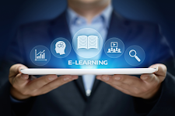
How we will look at this topic ??
The definition of E-learning
E-learning and it’s applications
Platforms for modern E-learning
Major issues involved in this mode of teaching
How can we counter this issue.

Slide 3
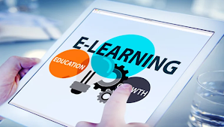
Definition of E-learning
“Learning system based on formalised teaching but with the help of electronic devices is known as E-learning.”

Slide 4

E-learning and it’s Applications
Widely used in inter-country meetings.
Common use of video-conferencing apps.
Human resource lectures were given through E-Learning.

Slide 5










E-Learning Platforms
Mainstream Platforms
Learning Institutes

Slide 6







LMS softwares

Slide 7
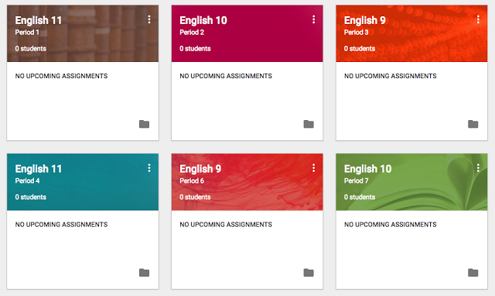
Workings of LMS software

Slide 9





Video-conferencing tools

Slide 10
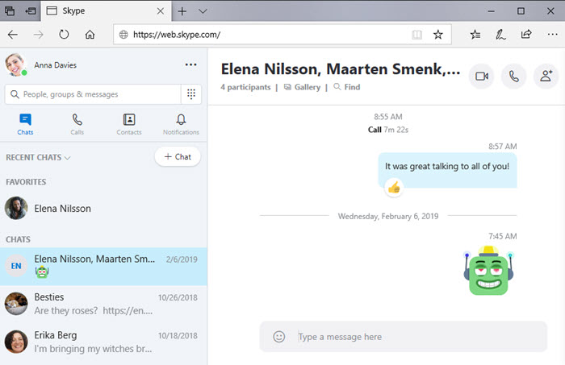
Workings of video conferencing

Slide 11
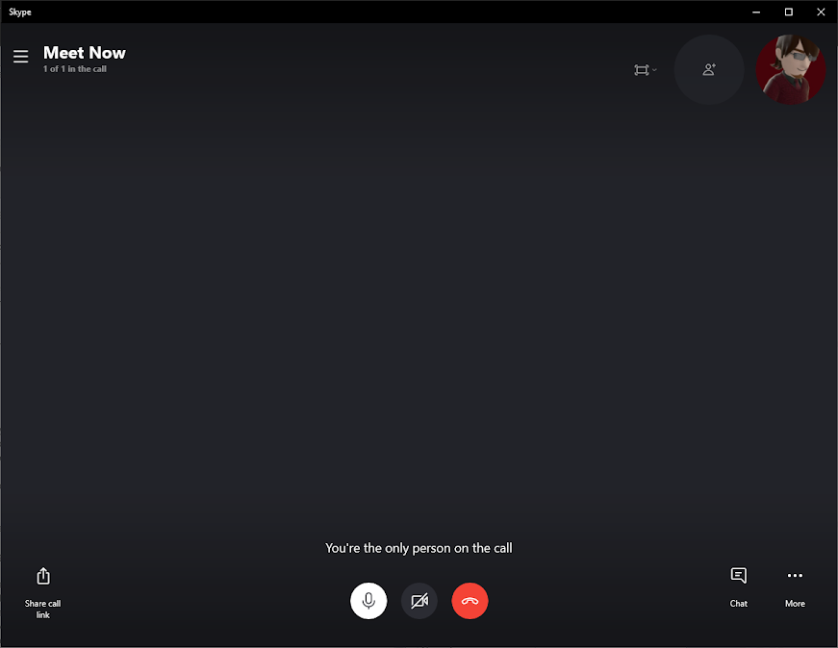

Slide 12
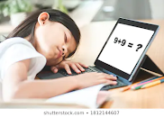
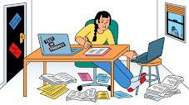
Issues in delivering this mode of teaching
Limited Student Feedback
Cheating during Exams
Lack of Face-to-Face Communication
Inaccessible for the Poor Class
Lack of Practical Learning

Slide 13

How can we counter the issues faced ??

Slide 14
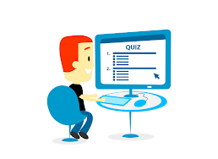
Use powerful tools.
By Using E-learning Tools.
Online whiteboards.
Regular online quizzes.
Video chats & discussions with teachers.

Slide 15

Use reliable software for test taking.
By Using reliable softwares.
Exam Proctor test taking.
Tests to be taken in a time frame.

Slide 16
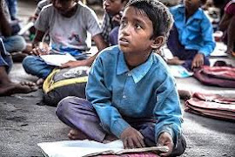
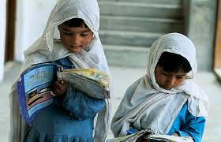
How will we solve the problem for underprivileged people in Pakistan??

Slide 17


How rest of the world is tackling this issue?
Distribution of Chromebooks.
Short-courses for Digital Literacy.
Establishment of Hotspot Cafes.

Slide 18
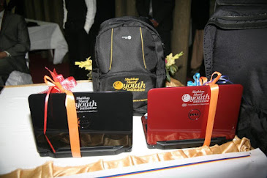
How our institutes can solve this problem?
Provide laptops or tablets with basic features.
Provide accessible internet packages.
Provision of short digital courses.
Simple web-apps can be made.

Slide 19
Review
We believe that after taking some necessary measures E-Learning can prove to be a very useful element, especially to increase the literacy rate of Pakistan. Until then, we need plenty of resources and a lot of optimism!

Slide 20


